Slide 1
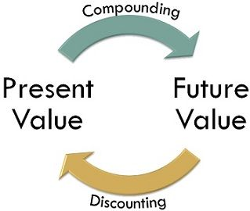

Slide 2
Techniques of Time Value of Money
Compounding Technique or Future Value Technique-
Compounding technique is used to calculate the future value of present money (cash flows). In this concept, the interest earned on the initial principal amount becomes a part of the principal at the end of the compounding period.

Slide 3
Discounting Technique or Present Value Technique-
Discounting technique is used to calculate the present value of cash flows. The concept of this method is "what should be the amount, we need to invest today" to get a specific amount in future. This technique helps to ascertain the present value of future cash flows by applying a discount rate.

Slide 4
Discounting converts future value amount into present value amount. Similarly, compounding converts present value amount into future value amount

Slide 5
THANK YOU

